Slide 1

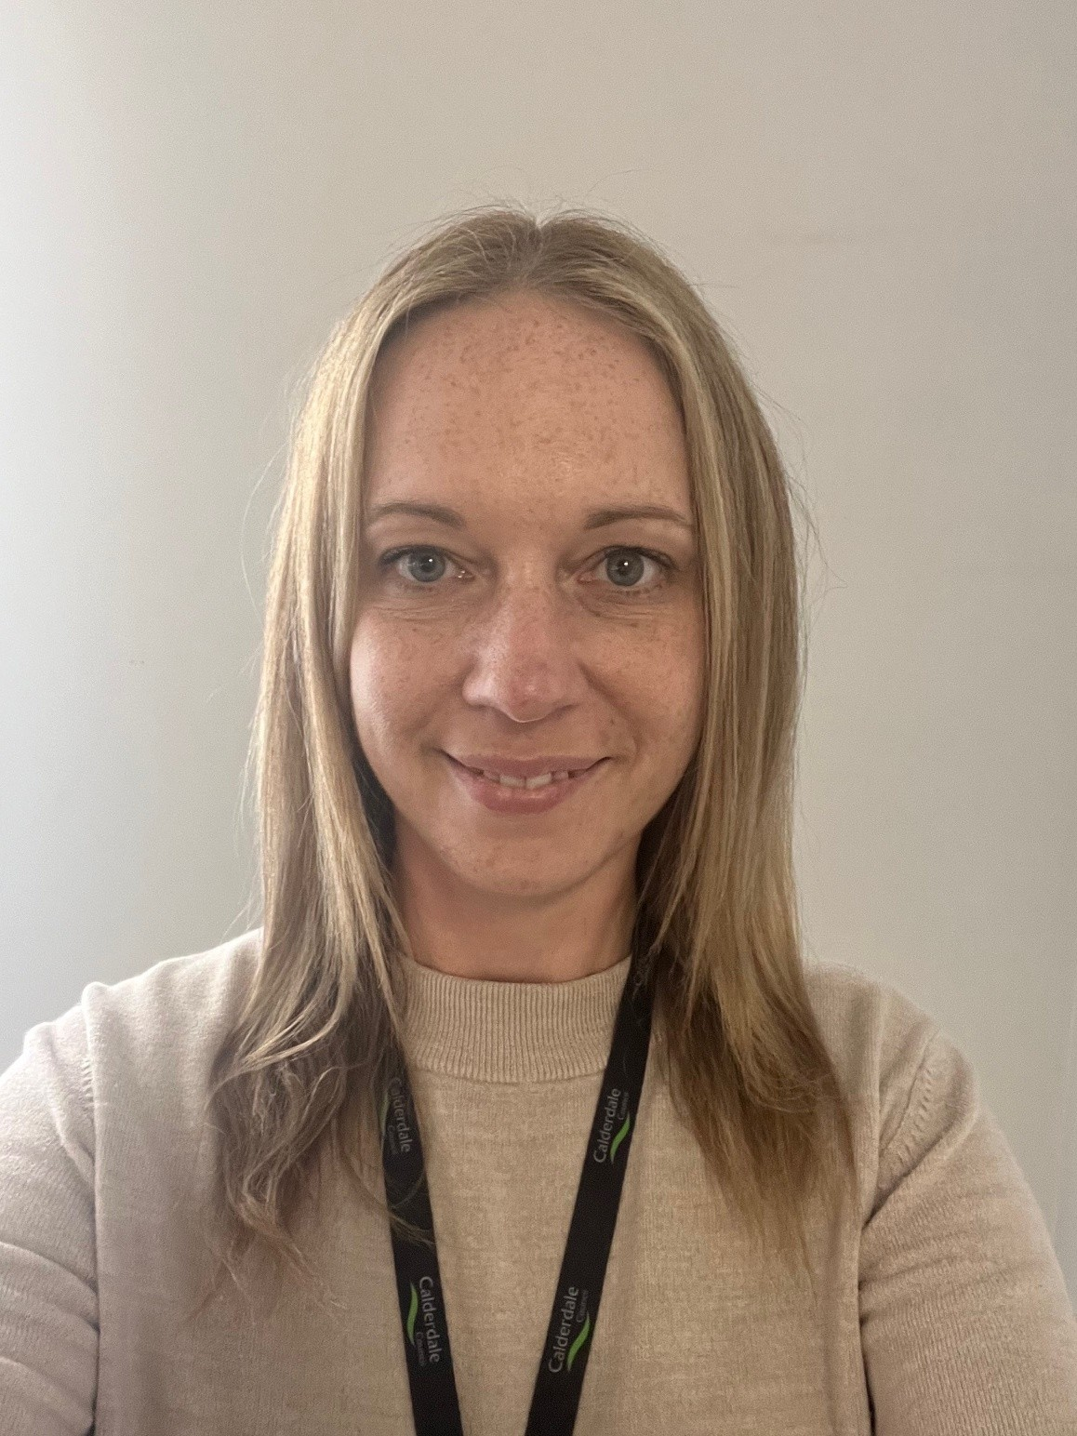
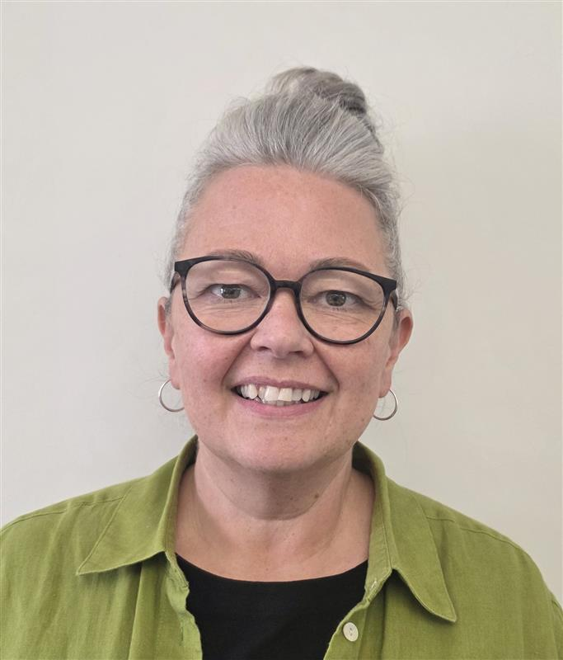
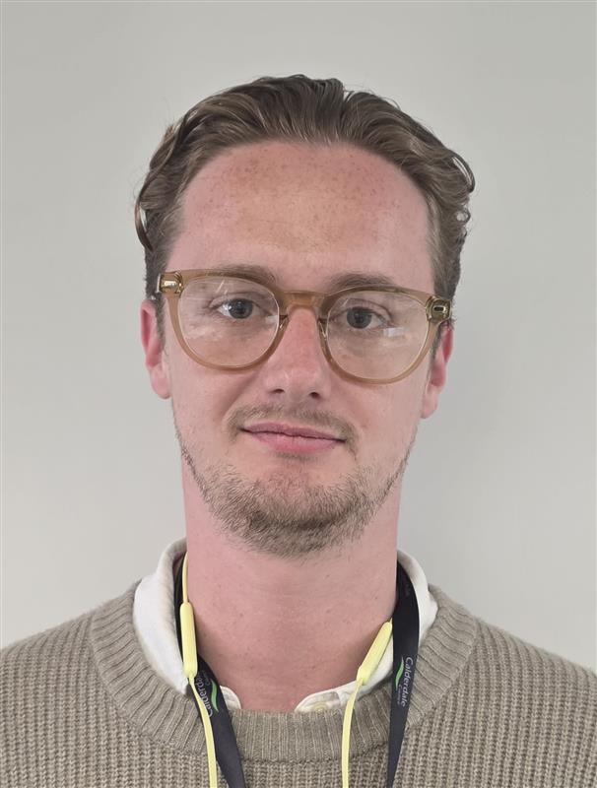
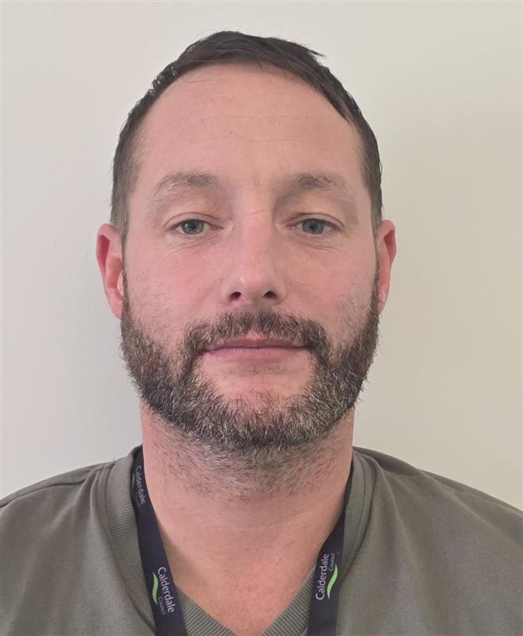
Direct Payment Monitoring Team
We are a new team, introduced as part of the Transformation project
We are responsible for auditing Direct Payment bank accounts and liaising with individuals, DP managers, accountants, the Direct Payment team and Social Care teams regarding our findings
We work collaboratively with others, to help in supporting individuals to use their account and funding effectively for their care needs to live a larger life
Kelly Harley
Team Leader
Gareth Kendall
Monitoring Officer
Bill Ashcroft
Monitoring Officer
Sharon Hanson
Monitoring Officer
Notes:
Who we are, our responsibility and how we fit the bigger picture

Slide 2
Key facts
The Care and Support (Direct Payments) Regulations 2014 legislation, outlines our responsibilities as a council when providing this service.
We are required to monitor how the payments are used to ensure they meet the intended care and support outcomes. This also includes safeguarding and taking action if there are concerns about misuse.
Volumes
- Approx 580 Adult
- Approx 200 Children's

Slide 3
How we monitor DP accounts
We ask for bank statements, invoices, wage slips
We compare the information and check the use of funds against the support plan to work out if there is any over or underspending
We check the care charges for an individual, where care is provided via Direct Payment only, as care charges are paid in to the Direct Payment bank account – we reconcile these
Record Keeping – keep clear records of regular audits on our system for future reference and to evidence we are meeting the requirements set out in legislation

